Slide 1
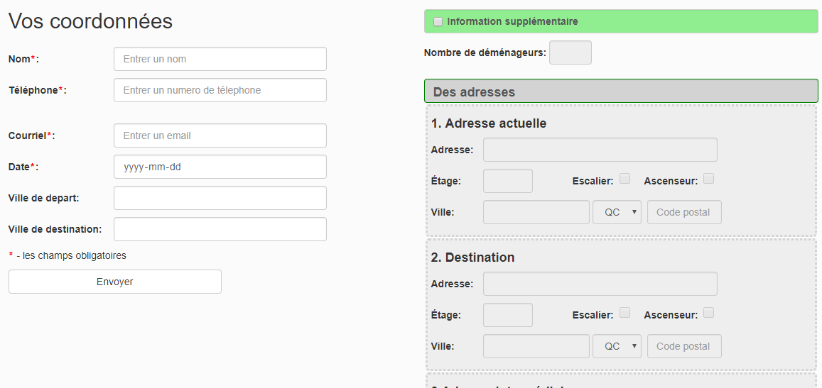
Estimation form-processing

Slide 2
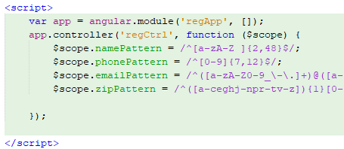
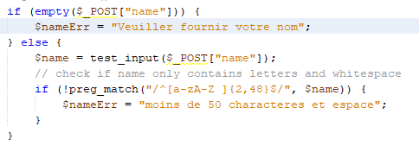

Form validation-client side / server side
If there are data to be corrected, whatever user entered will stay, so user just need to correct fields where need to be corrected. To do this, have add below php code into html tage

Slide 3
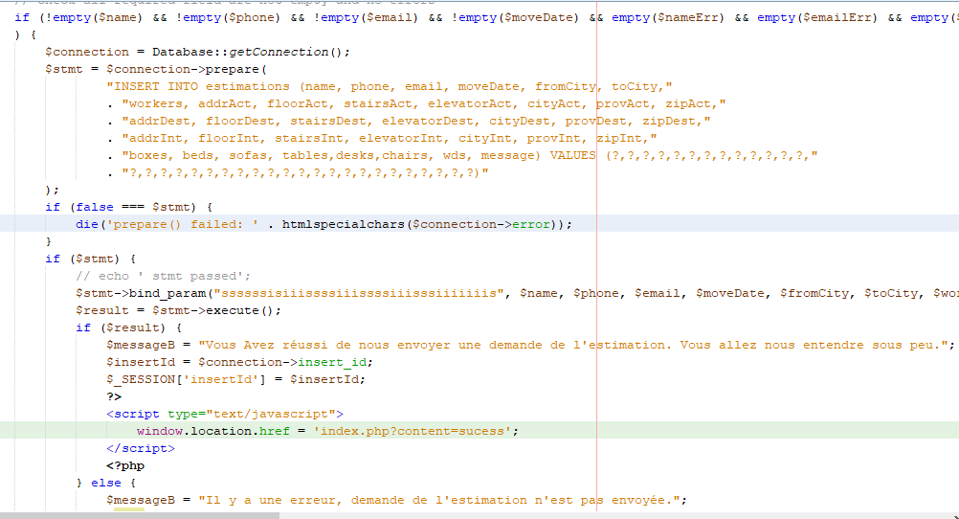
Save to database – error checking

Slide 4
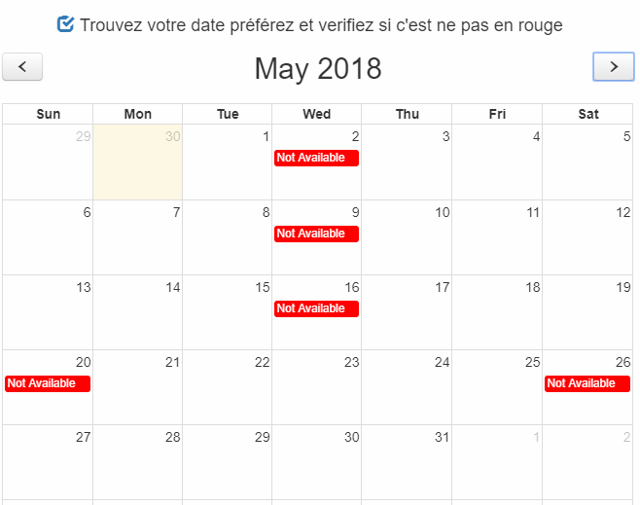
calendar - We have a dynamic calendar which fetches the data from database and display the unavailable dates on the calendar.

Slide 5
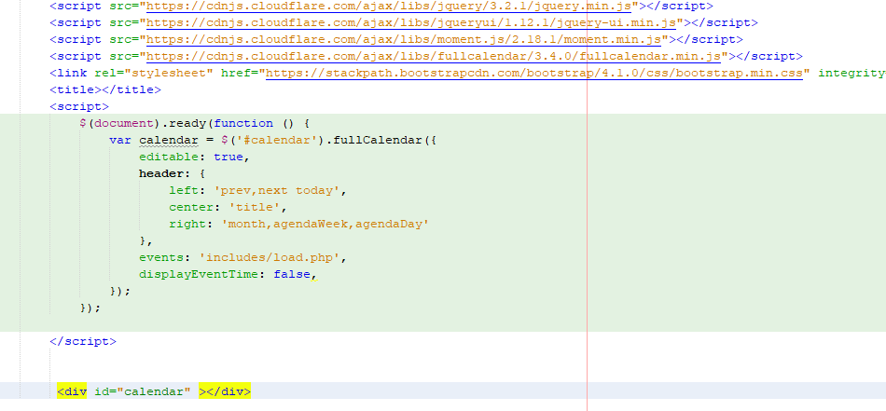
Calendar – used fullcalendar plug in

Slide 6
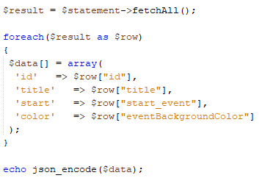
calendar
How to pass data fetched from database by php to Jquery script ?
Here is the little trick:

